Slide 1

TOWN OF Cave creek
Staff Update
Grant & Stakeholder Opportunities
March 31, 2026

Slide 2

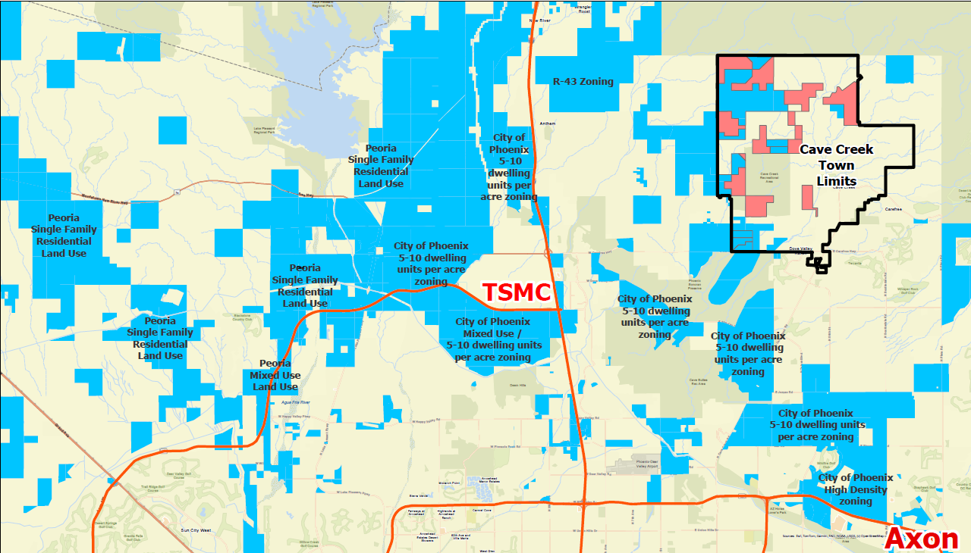
BACKGROUND
2025- The Town Council appointed a 15 resident-member taskforce to examine the ASLD Open Space and provide recommendations to the Town outlining options to proceed with acquisition.
Map illustrates ASLD land holdings in the north valley totaling, approximately, 100,000 acres of development-ready land (BLUE).

Slide 3

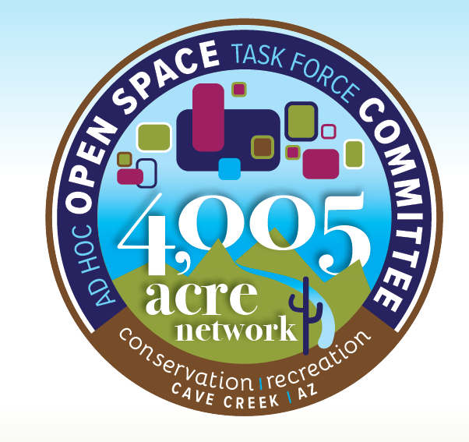
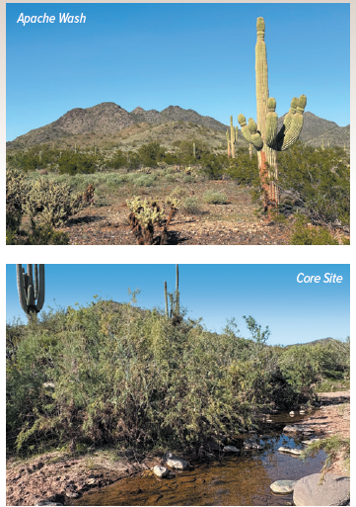
TaskForce Recommendation
The Taskforce found that there are multiple stakeholders which could support the acquisition of the Open Space ranging from government agencies, non-profits and private or commercial donorship.
  Staff continues to meet with Maricopa County officials
  The Town and DFLT are working to finalize an agreement to potentially assist with fundraising
  Once a mechanism is in place, donors can be solicited

Slide 4
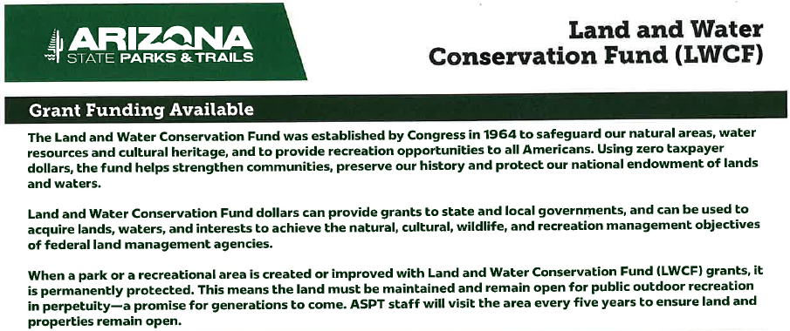
Additional funding sources (acquisition)
Staff met with AZ Parks and Trails and provided a tour of the Open Space areas concluding that the acquisition would be a perfect candidate for the LWCF Grant.
Currently the dollar-for-dollar award in a year is 1.5M with discussion to increase to 2M.
Acquisition is a top priority project for the endowment fund.
Town and County could each apply for maximum amount with separate applications.
The required matching fund dedication and perpetuity of acquired lands discourages other applicants from pursuing the grant

Slide 5
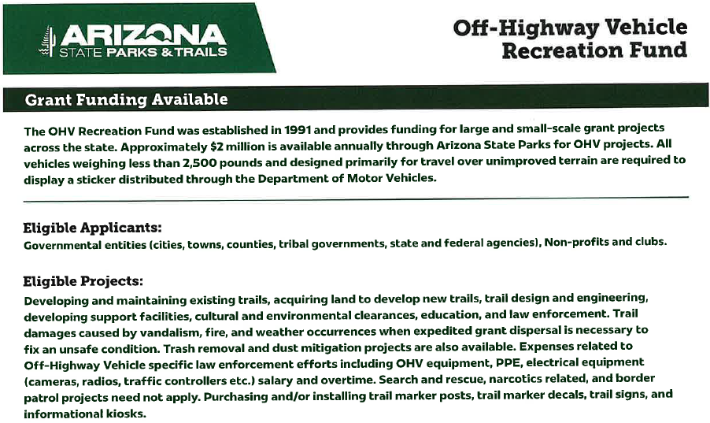

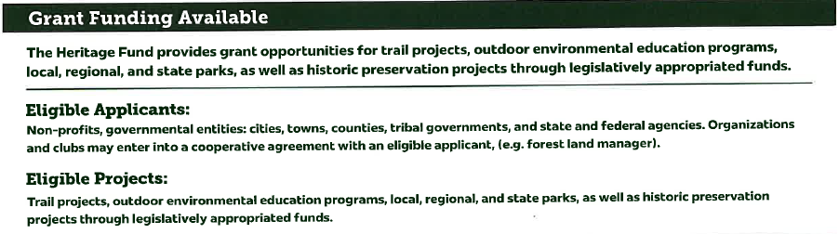

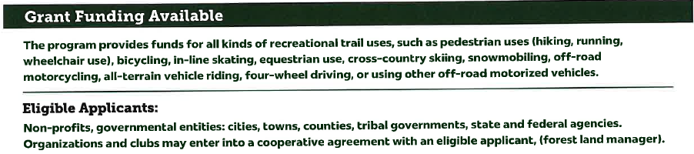
Additional funding sources (MANAGEMENT)
These Grant opportunities would assist with restoration of wildcat trails, improvement of new trails, fencing off areas most susceptible to trespass or illegal non-motorized trail uses and clean up of illegal dump sites.

